Slide 1

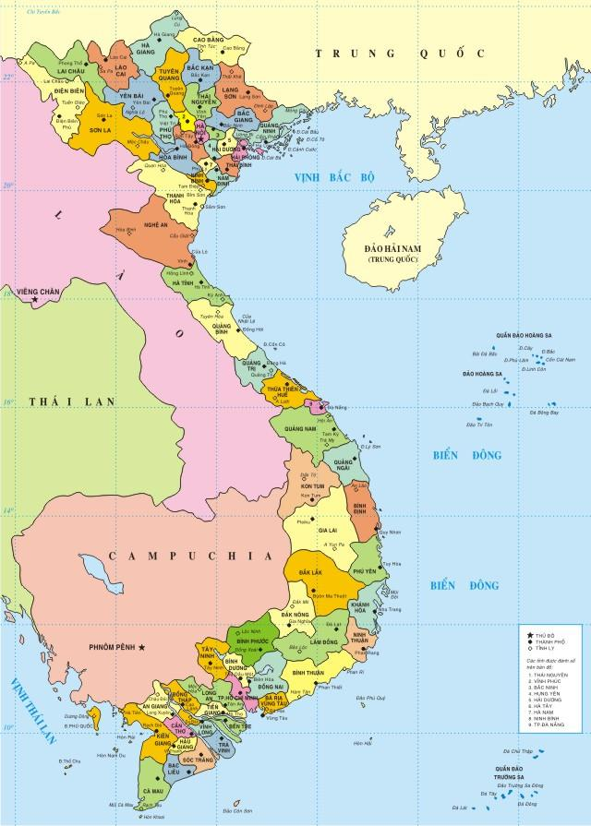
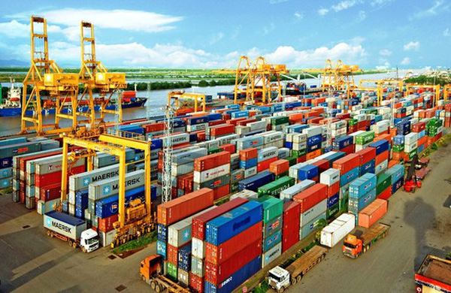
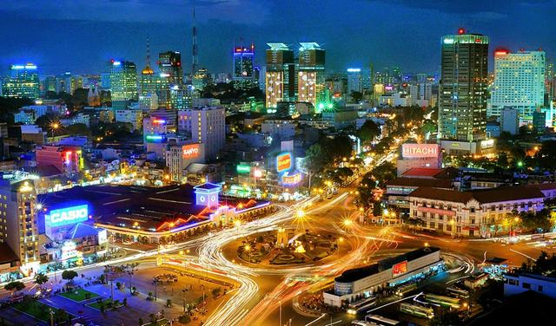
VIETNAM -
A POTENTIAL BUSINESS PARTNER

Slide 2
VIETNAM ECONOMY – Milestones in International Integration
1986 Doimoi Renovation
1993 Partnership with WB, IMF
1995, 1998
ASEAN Membership
APEC Membership
2007
WTO Accession
2019, 2000
CPTPP in effect
VN-EU FTA in effect
RCEP signed

Slide 3
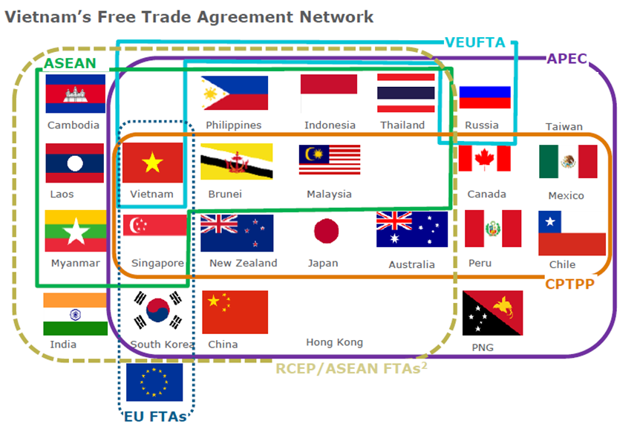
The country actively engaged in the world economy - member of 15 FTAs which cover 59% global population and 68% global trade.
VIETNAM - A Hub of 15 Free Trade Agreement Network

Slide 4
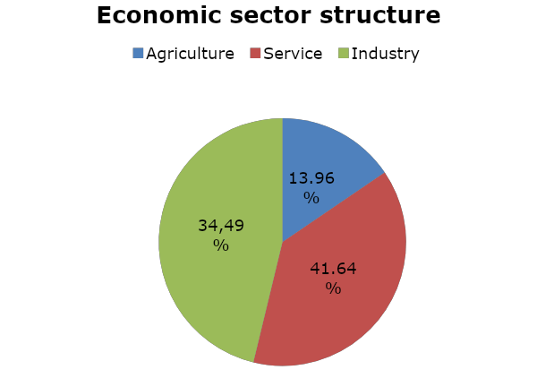
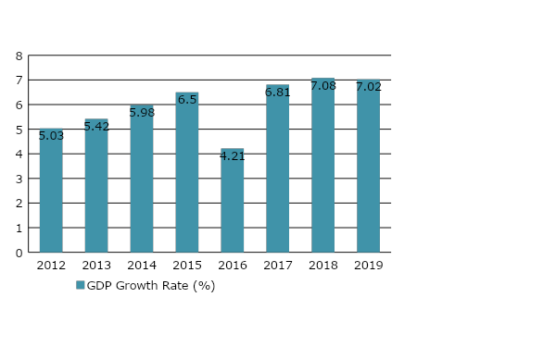
VIETNAM ECONOMY - GDP & Economic Sectors
GDP 2019: 7.02%, highest rate in two consecutive years
GDP: 266,5 billion USD, GDP per capital: 2,780 USD
Export 2019: 263.45 billion USD
Import 2019: 253.51 billion USD

Slide 5
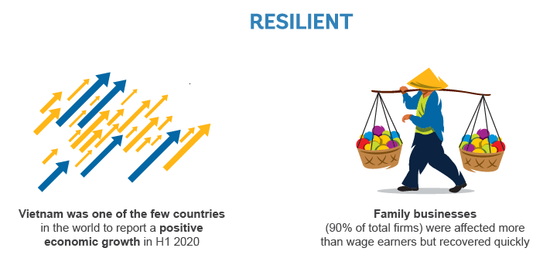
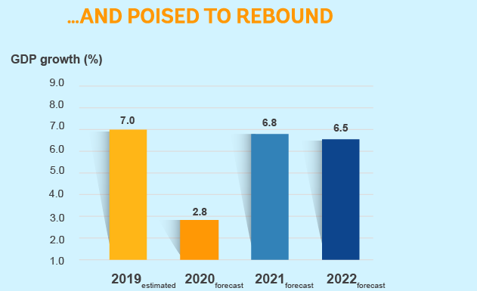
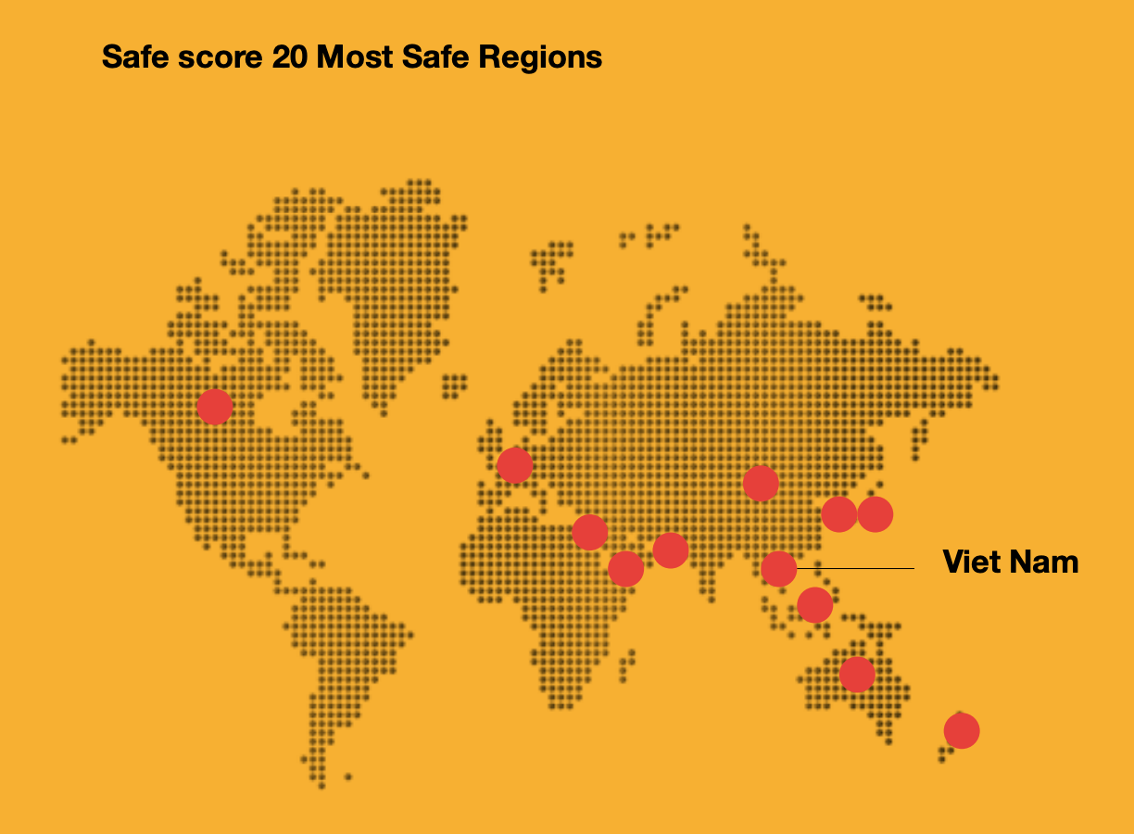
VIETNAM ECONOMY – Snapshort during Covid 19

Slide 6
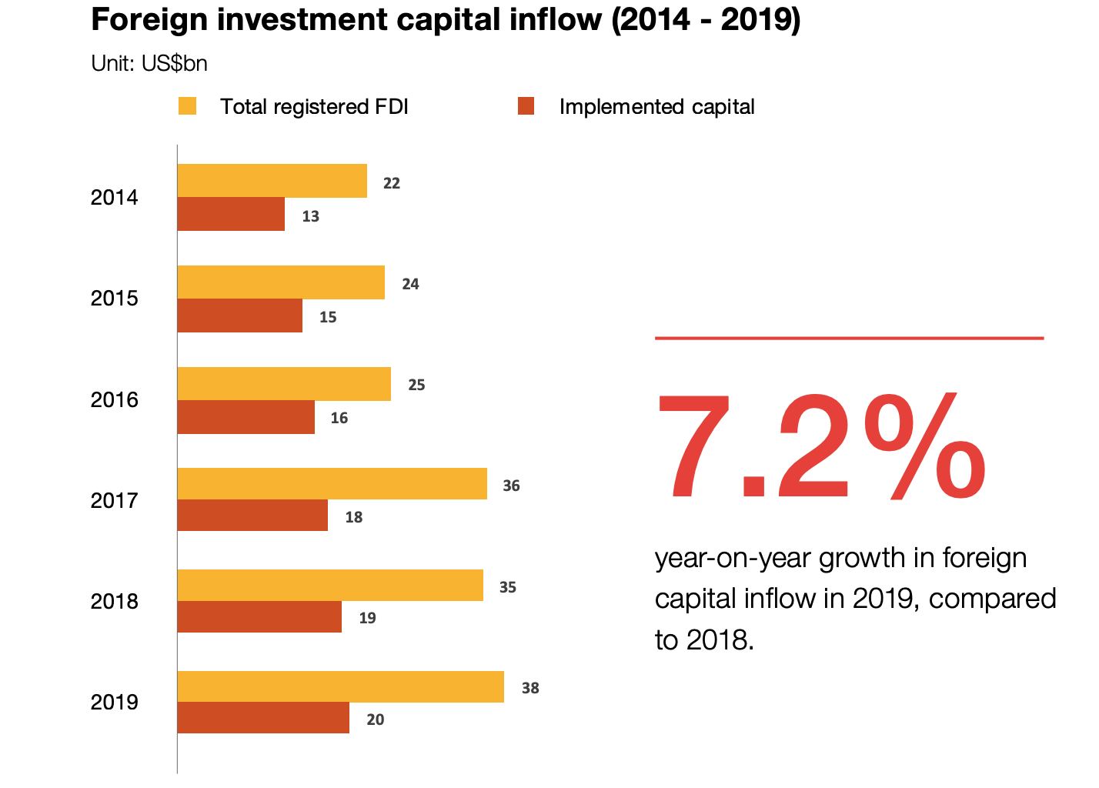
FDI has been great contributor to the country’s economic growth and is consistently one of the driving forces behind Viet Nam’s high growth rate.
VIETNAM FOREIGN INVESTMENT

Slide 7
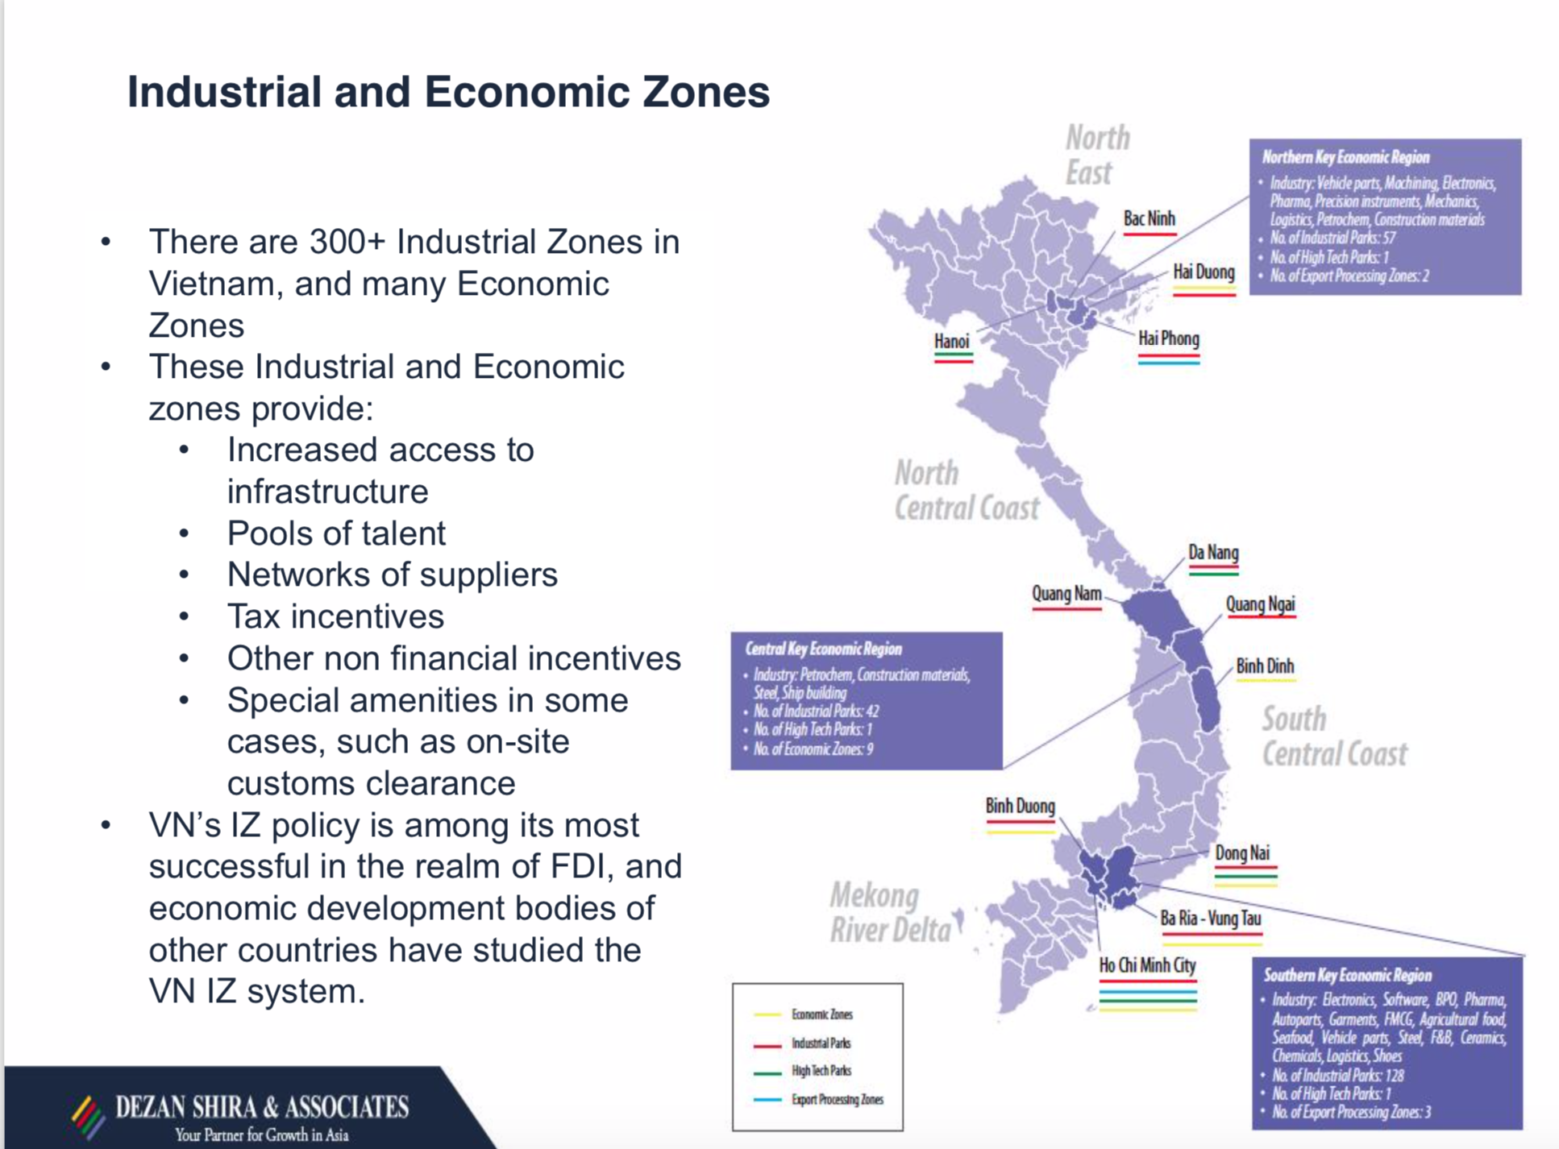
VIETNAM FOREIGN INVESTMENT

Slide 8
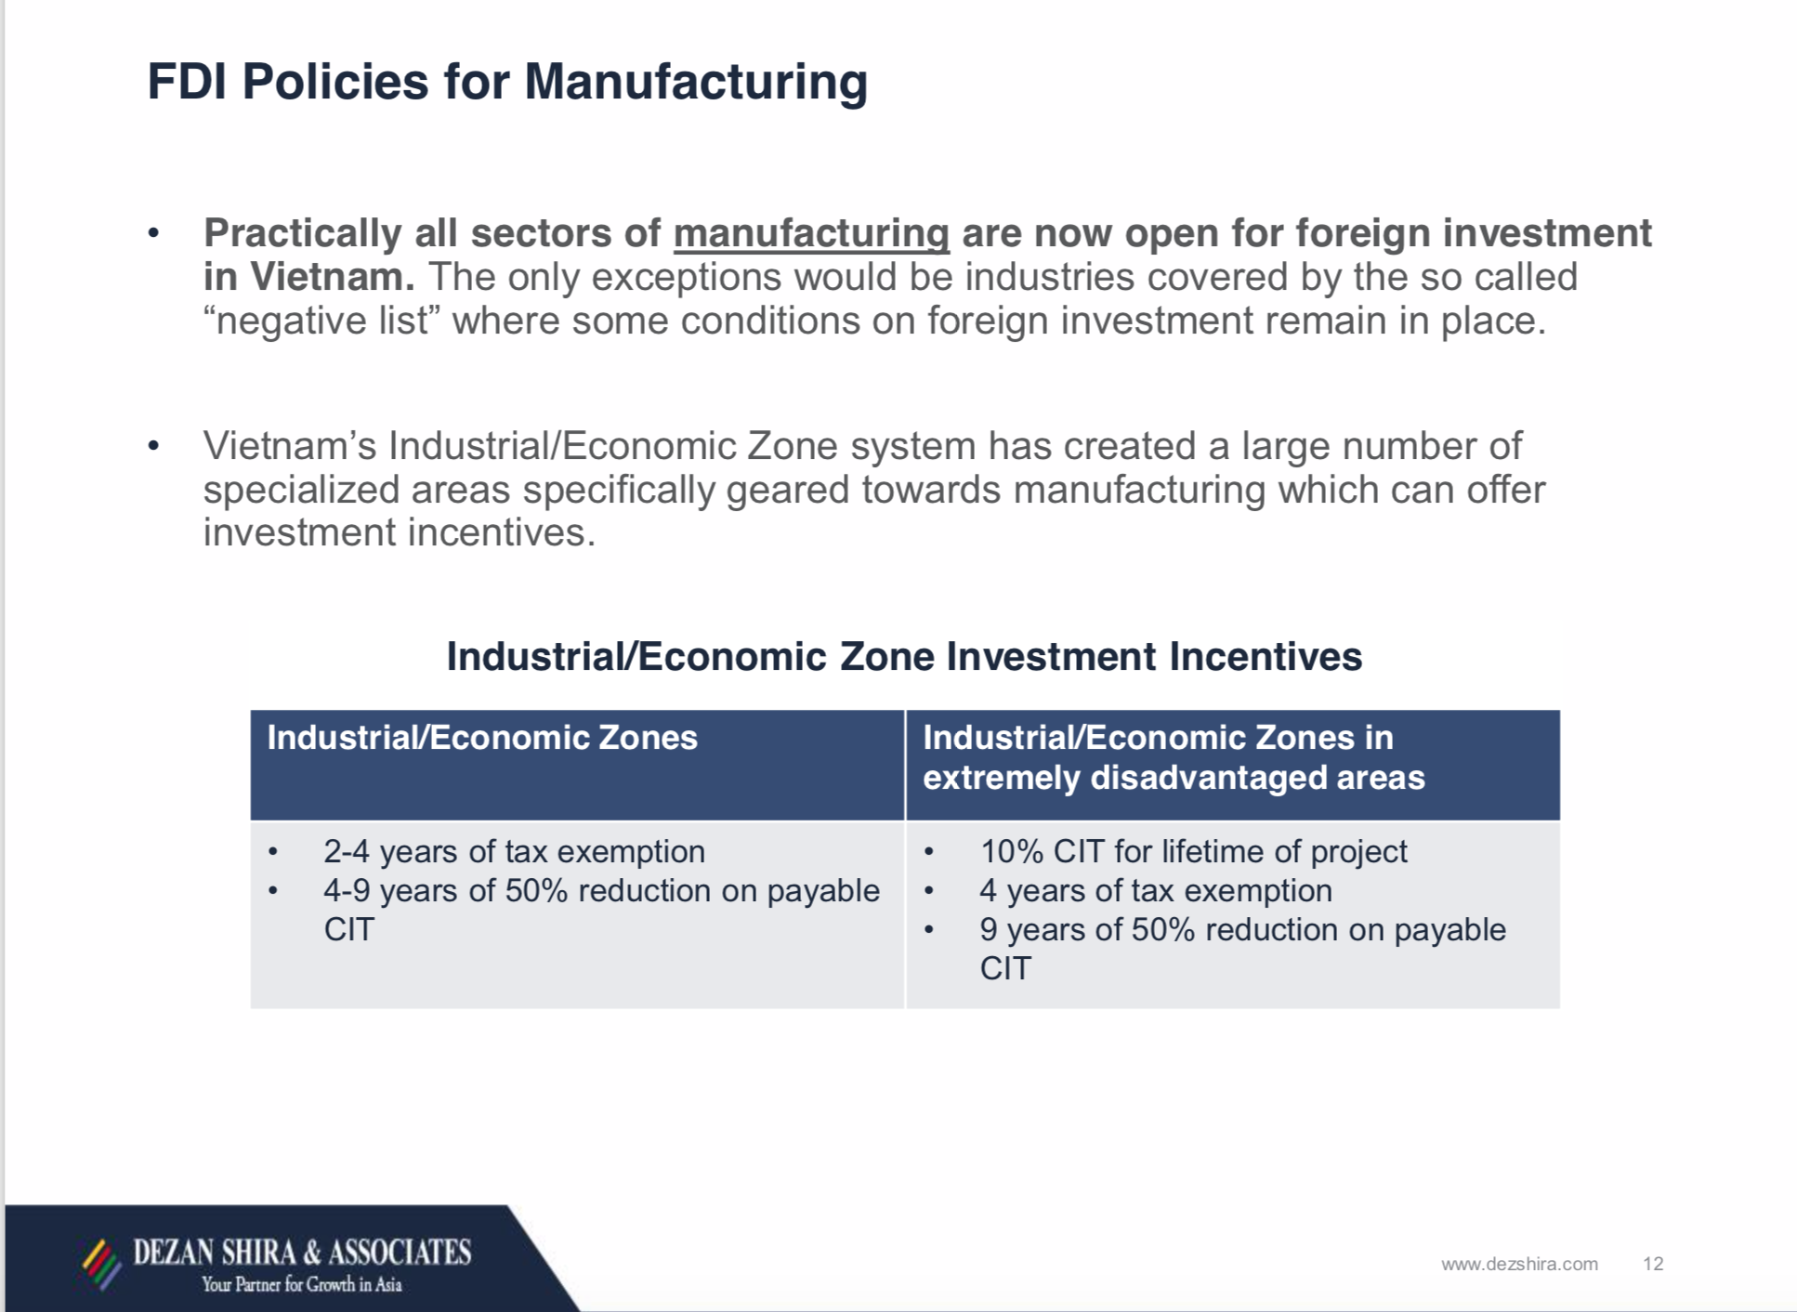
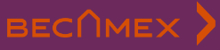
FOREIGN INVESTMENT - Incentives

Slide 9


































































VIETNAM FOREIGN INVESTMENT (Global partners)

Slide 10
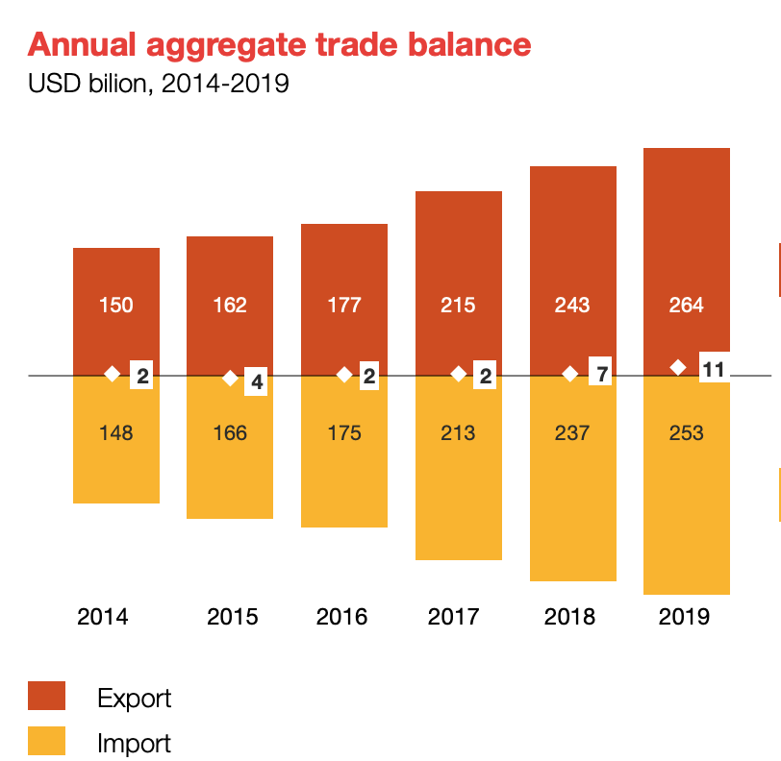
International integration has driven huge increases in cross-border trade. Since 2014, export and import average annual growth rate have been 12% and 11% respectively
MERCHANDISE TRADE

Slide 11
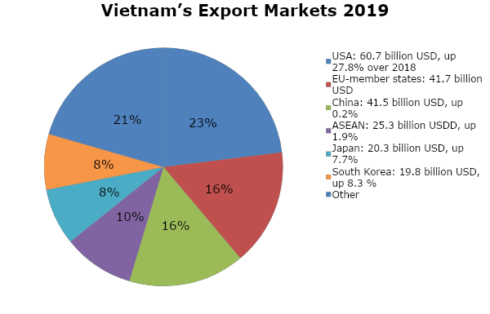
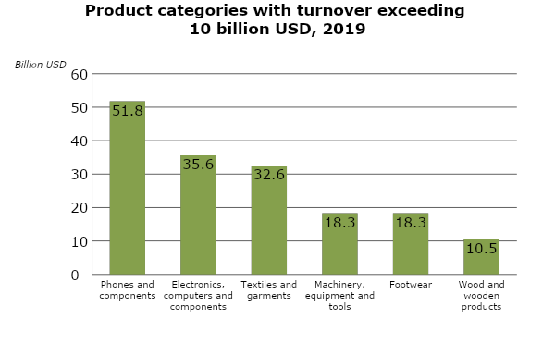
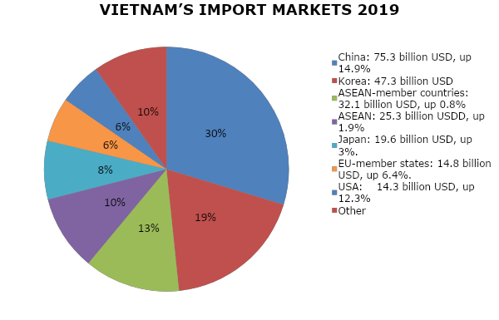
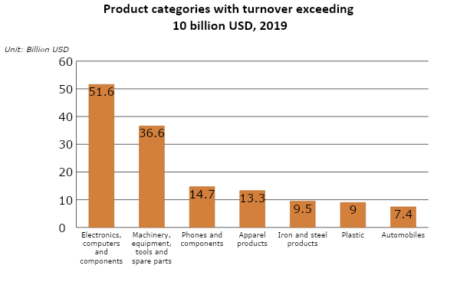
VIETNAM - MERCHANDISE TRADE
Key export products
Key import products

Slide 12

VIETNAM–CANADA: Bilateral Economic Relations
Vietnam - Canada’s largest trading partner in ASEAN
Vietnam – Canada’s 5th largest trading partner in Asia
Canada - Vietnam’s14th largest foreign investors
Vietnam & Canada – members of Comprehensive and Progressive for Trans-Pacific Partnership (CPTPP)
2-way merchandise trade US$ 4.8 billion (2019)
Vietnamese exports to Canada US$ 3.6 billion in Jan - Oct 2020, increased by 13.7%

Slide 13
VIETNAM-CANADA: Bilateral Merchandise Trade
Vietnam’s export to Canada
(USD million)
Vietnam’s import from Canada
(USD million)

Slide 14
VIETNAM-CANADA: CPTPP IMPORT DUTY ELIMINATION
VIETNAM’S BENEFICIARY
  Agri-food
  Apparel
  Footwear
  Furniture
  Components & Parts
  Home Décor
  Rubber and Plastics Products
CANADA’S BENEFICIARY
Beef products
Pork products
Cherries/Blueberries
Cosmetics
Ice wine and whiskey

Slide 15









Opportunities for Canadian investment in Vietnam
Clean Tech
Infrastructure
Information Communication Technology
Renewable energy
Waste
management solutions
Metro
Highway
High-end
Real Estate
Climate resiliency planning
Building Materials
Airport

Slide 16
VIETNAMESE ASSOCIATIONS
 | Sectors | Website
1 | Seafood | http://vasep.com.vn/
2 | Handicraft | https://vietcraft.org.vn/
3 | Furniture and Home Decor | http://www.hawa.vn/en; http://www.bifa.vn/; http://vietfores.org/
4 | Textile | http://www.vietnamtextile.org.vn/; https://www.agtek.org.vn/
5 | Footware | http://www.lefaso.org.vn
6 | Steel | http://vsa.com.vn/
7 | Supporting industry | https://vasi.org.vn/en/
8 | Agri-food | https://www.vietfood.org.vn/en/
9 | Tea | http://www.tea-vietnam.com/
10 | Coffee | http://www.vicofa.org.vn/
11 | Pepper and spices | http://peppervietnam.com/

Slide 17

THANK YOU VERY MUCH
Contacts: Ms. Do Thi Thu Huong, Commercial Counselor
Tel: (+1) 613 715 9683; Email: vinatrade@rogers.com

